Slide 1
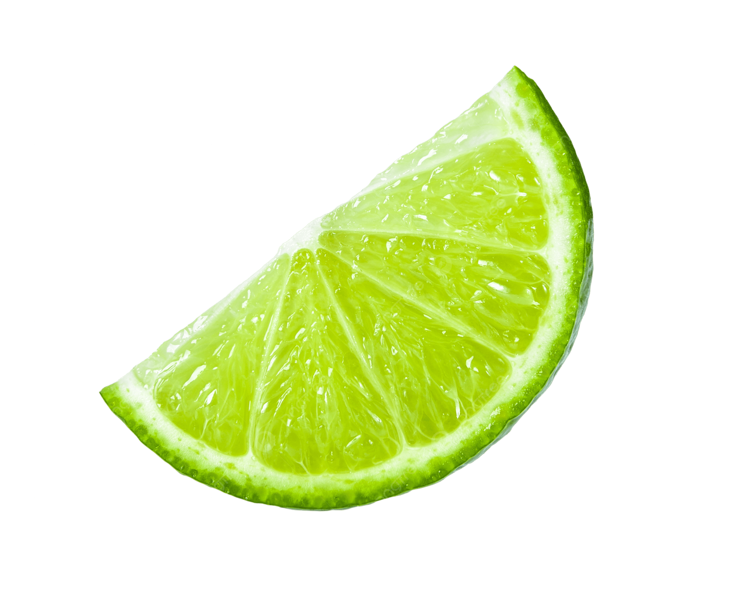
A Hint of Lyme
The Effects of CaCO₃ on Hemigrapsus oregonensis
Bailey Snodgrass, John Plinka, Sean Berry

Slide 2
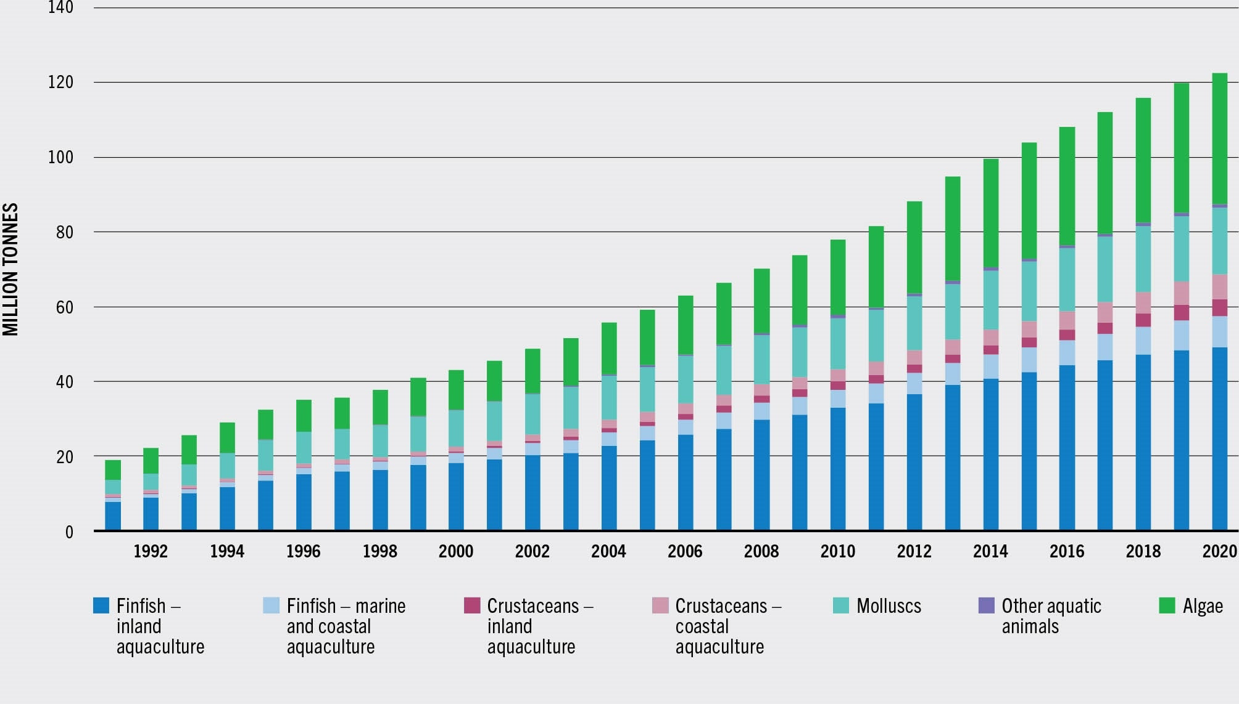
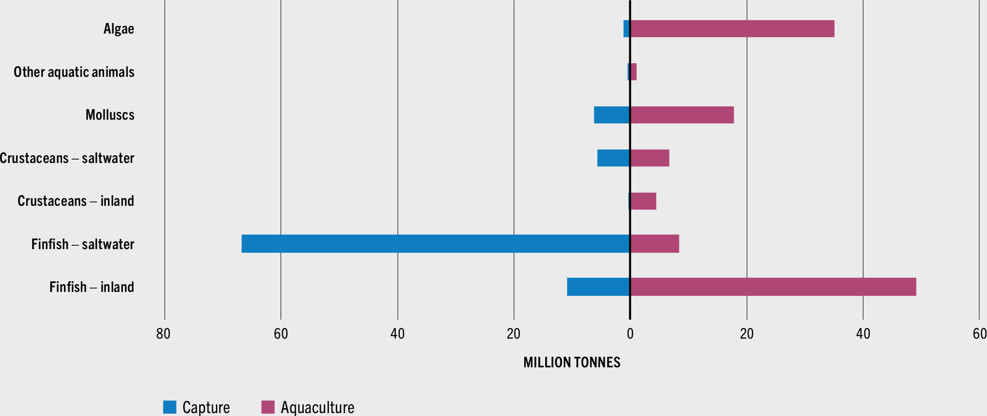
Introduction
Global harvest in 2018: 6.9 million tonnes of crustaceans ($36.1 b USD) (NOAA, 2021)
Between 2018 and 2020, aquaculture live weight globally jumped from 115.9 million tons to 122.6 million tons (FAO, 2022)
Fig 1). World Aquaculture Production 1991-2020 (Source FAO)
Fig 2). Aquaculture Composition by Functional Species Group 2020 (Source FAO)

Slide 3
Background
Mineral accumulation of heavy metals have been observed in RAS (Recirculating Aquaculture Systems), and have been shown to have effects on other aquaculture relevant species such as the Nile tilapia (Oreochromis niloticus) (Martins et al. 2010)
Alkalinity increases can result from increased CaCO₃ levels, and alkaline conditions can have adverse effects on internal physiological functions
Higher [Ca²⁺] levels were found to facilitate molt in S. paramamosain (Zhang et al., 2024), and build up within the exoskeleton and the gills was observed

Slide 4
Research Question
Research Question: How will dissolved calcium carbonate affect Hairy Shore Crab (Hemigrapsus oregonesis)?
Hypothesis 1 (Calcium Carbonate): Excess dissolved calcium carbonate in the water will bind to both their shells and to their gills internally, limiting their ability to respire
Null Hypothesis 1 (Calcium Carbonate): Excess calcium carbonate will have no effect on the crabs
Hypothesis 2 (Temperature): Increased temperature stress will further exacerbate the the effects of the calcium carbonate and lead to higher mortality rates
Null Hypothesis 2 (Temperature): Temperature will have no effect on the physiological impacts of the calcium carbonate

Slide 5
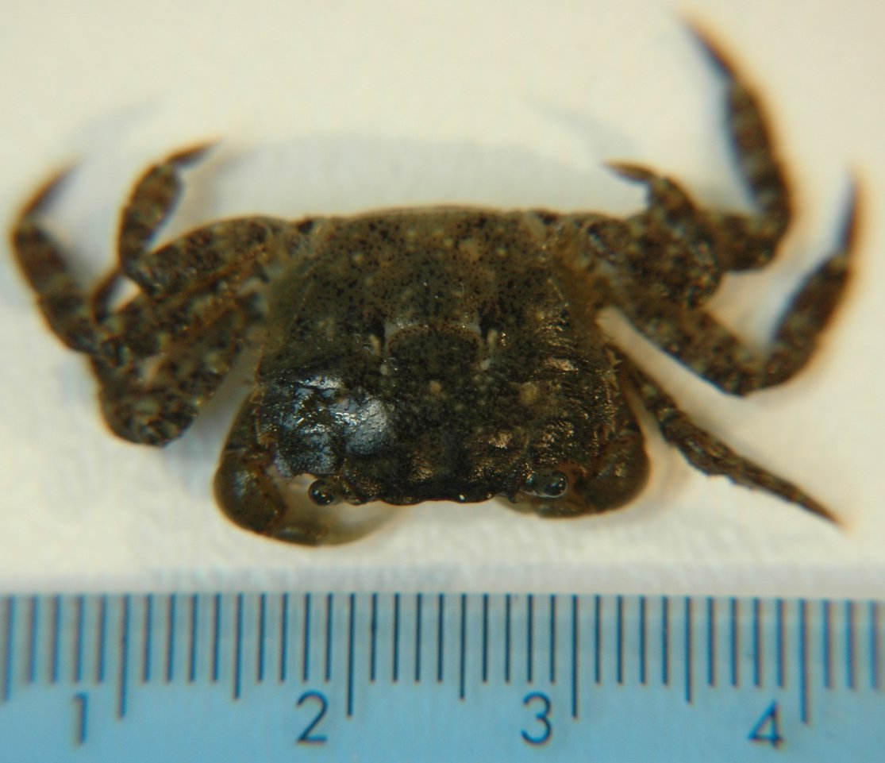
Materials
Hairy shore crabs (H. oregonensis) n=15; control population
Three 2-L tubs: n=5/ea.
Heat controlling device
Air stone
CaCO₃ lime powder
Instant Ocean mix
Saltwater calcium concentration test kit
Disposable syringe
Cayman chemical L-Lactate assay kit
Fig. 3) The hairy shore crab, Hemigrapsus oregonensis

Slide 6
Methods
CaCO₃ lime weighed out to 1.000g and dissolved into 2-L tubs
1 mg CaCO₃ = 0.4 mg Ca²⁺
Raised [CaCO₃] from ~400 mg/L to 600 mg/L
Placed into one of two tanks: 13º C or 27º C
Air stone maintained dissolved O₂
Samples and tests conducted at weekly intervals (day 7 and 14)
One hemolymph extraction per tub when possible
One to two righting tests per tub
Hemolymph processed with L-Lactate assay kit and results recorded

Slide 7
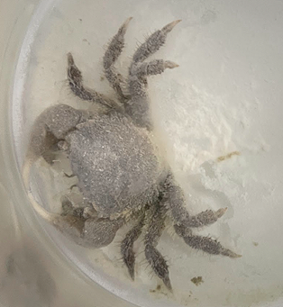
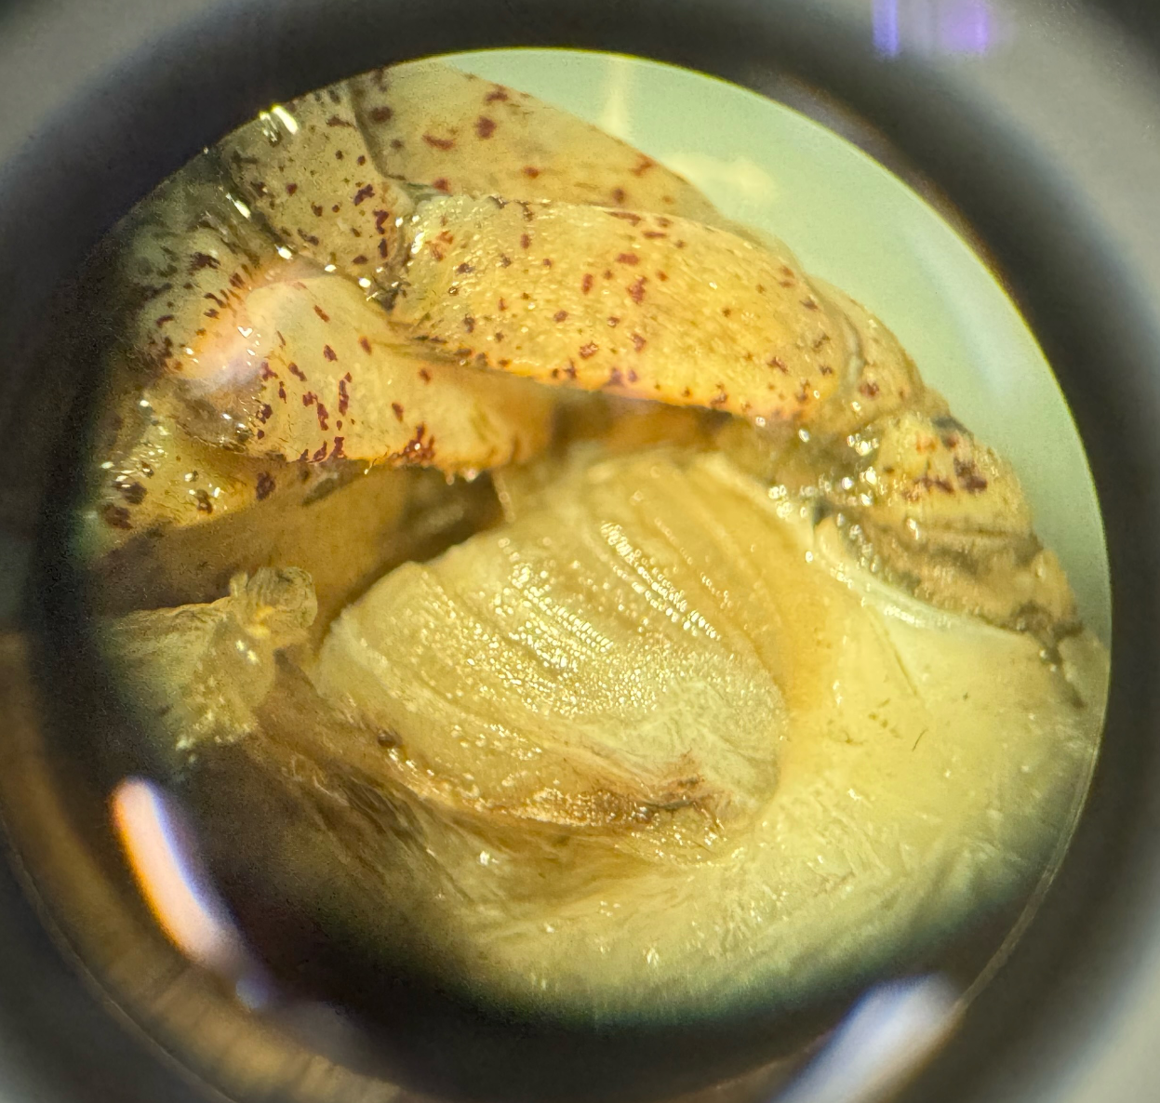
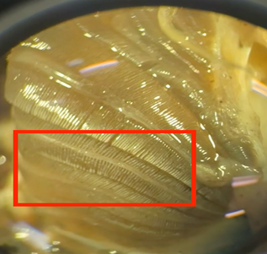
Results - Calcium accumulation
Fig. 4) Typical gill of H. oregonensis under baseline regime
Fig. 5) Accumulation on gills of H. Oregonensis in H-Ca⁺
Fig. 6) Accumulation on carapace of H. Oregonensis in C-Ca

Slide 8
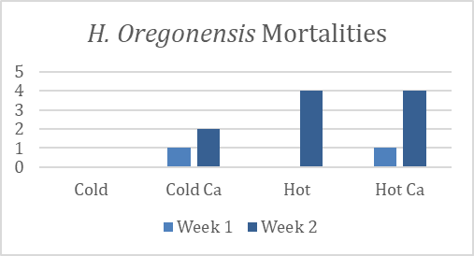
Results - Mortalities
Impact on respiration may have been the driving factor in resulting mortalities
Overaccumulation may have occurred and homeostatic process hindered
Fig. 7) Mortalities of H. oregonensis under each experimental regime

Slide 9
What does it mean?
Foundational study
Evidence of particulate build up in gills
Temperature increases may accelerate build up
No connection between lactate and treatment
Methodology hindered physiological assessment
Notes:
Foundation - effects of reduced carbonate for calcifying marine organisms is well documented, as is heavy metal toxic build up in, but consequences of over saturation of buffering salts are unexplored or at least undocumented.
Evidence - visual assessment shows mineral build up on bodies and in gills for both the cold and warm water treatment with augmented calcium carbonate concentrations.
Temperature - observable difference between build up in cold water and warm water, following logic of more particulate in warm water
Lactate - Our data did not elucidate an underlying connection between lactate levels and treatment, but that does not mean those relationships do not exist.
Data collection methods, sample handling errors, and whole treatment mortality events hindered our ability to validate physiological findings.
In repeating this experiment, we would include resazurin testing to help link oxygen consumption to gill condition.We would also take weight for each organism to quantify the build up of calcium carbonate and would euthanize all crabs to examination at the end of the study. This would allow tissue analysis to verify the particulate as calcium carbonate

Slide 10
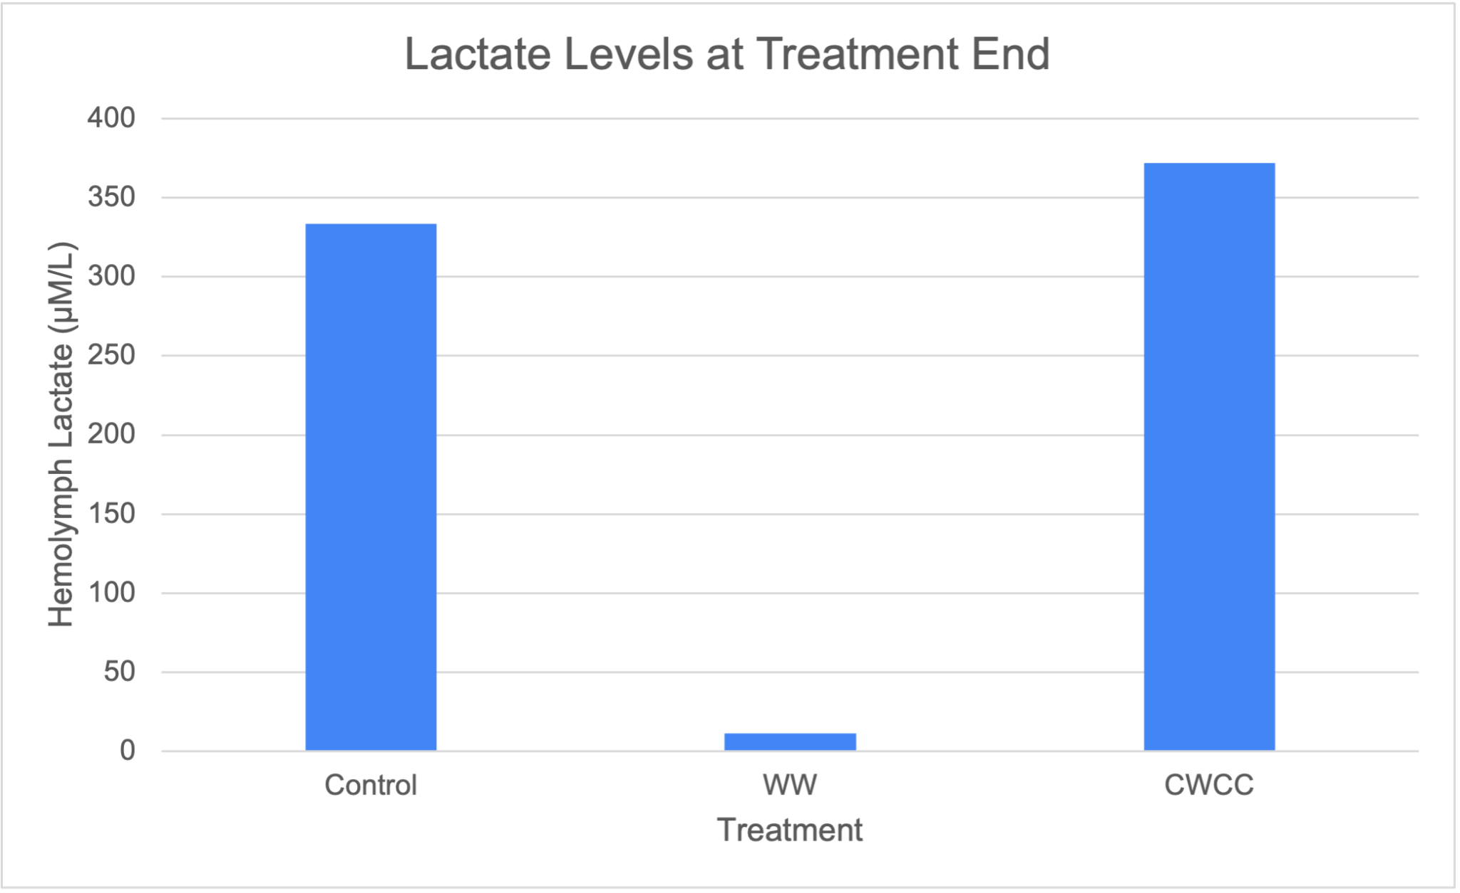
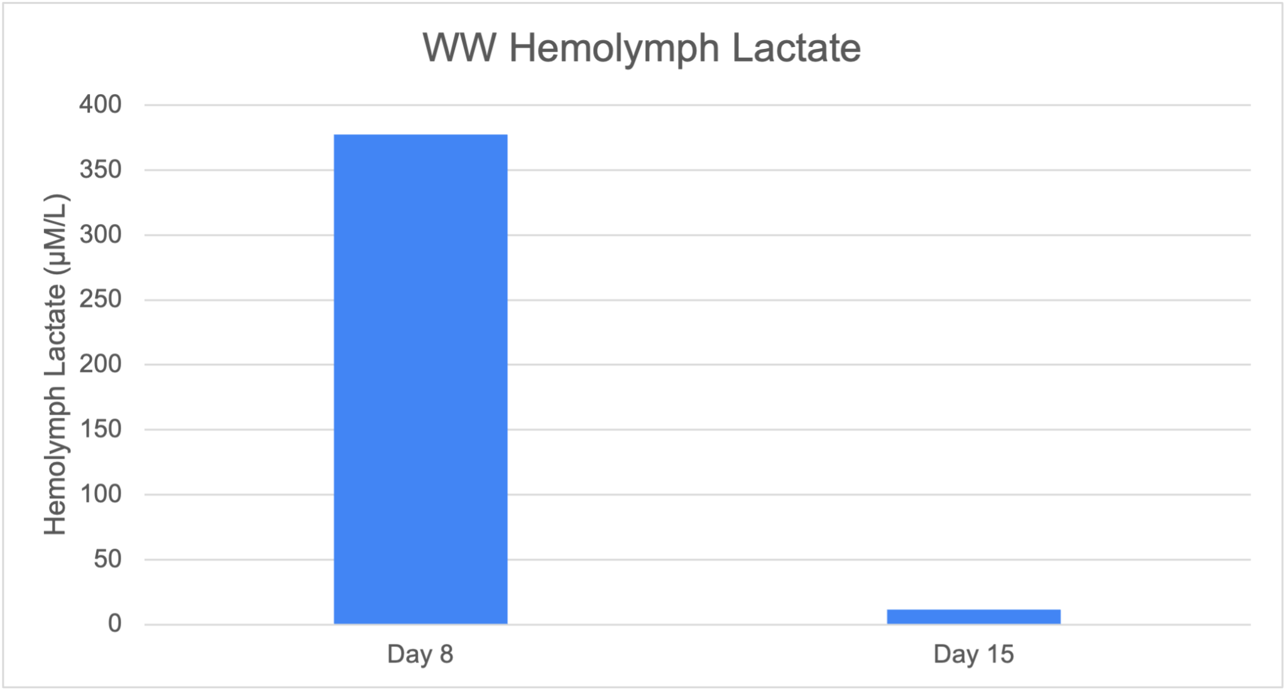
What’s next?
Resolve temperature impacts on particulate accumulation
Repeat experiment with other popular ph buffers
Investigate unexpected lactate assay results
Notes:
Temperature - species specific temperature profiles may reveal subtle differences in physiological
Buffer- potassium carbonate and calcium hydroxide, determine best combination of temp and salt per species
Assays - unexpected results in lactate levels, further physiological assays needed to asses

Slide 11
Who cares?
Aquaculture Managers!
Most valuable stock for least expensive conditions
Industry expansion
More humans = more potential human error
Notes:
Stock - consider conditions around system to determine the best stock based on temperature and buffer management strategies as part of the larger value assessment
Industry - increasing demand drives new opportunities, species and temperature specific information will reduce expansion costs in the form of reducing loss to system calibration
Having established thresholds for target stock can inform management strategies to reduce the risk of poor temperature maintenance or buffer application

Slide 12
References
NOAA (2021, June 8). Global Aquaculture. NOAA. https://www.fisheries.noaa.gov/national/aquaculture/global-aquaculture
Perry, H., Trigg, C., Larsen, K., Freeman, J., Erickson, M., & Henry, R. (2001). Calcium concentration in seawater and exoskeletal calcification in the blue crab, Callinectes sapidus. Aquaculture, 198(3), 197–208. https://doi.org/10.1016/S0044-8486(00)00603-7
Zanotto F.P. and Wheatly M.G. (2002) Calcium balance in crustaceans: nutritional aspects of physiological regulation. Comp Biochem and Phys, 133(2003), 645-660.
Zhang, Y., Gao, W., Yuan, Y., Cui, W., Xiang, Z., Ye, S., Ikhwanuddin, M., & Ma, H. (2024). Impact and accumulation of calcium on soft-shell mud crab Scylla paramamosain in recirculating aquaculture system. Aquaculture, 593, 741323. https://doi.org/10.1016/j.aquaculture.2024.741323

